Slide 1
Entity Relationship Diagram- Part 2

Slide 2
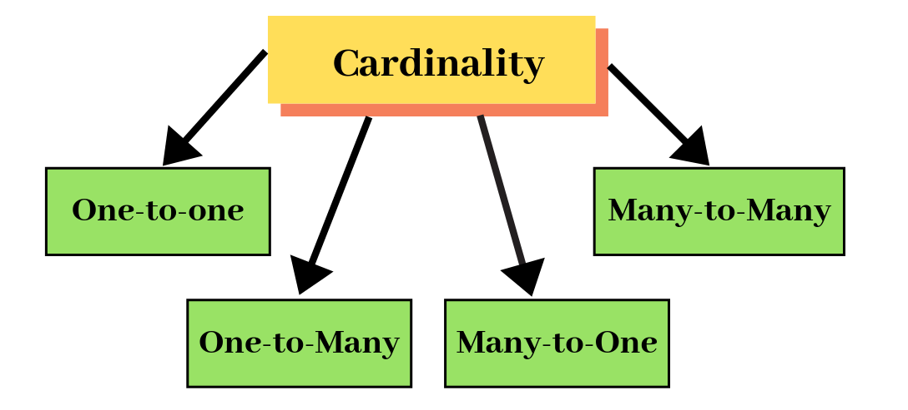
Cardinality
it’s the number of distinct values in a table column, relative to the number of rows in the table.

Slide 3
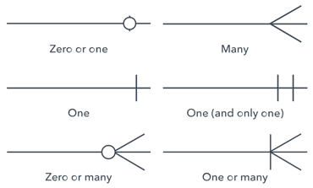
Notations
Crow Notation

Slide 4
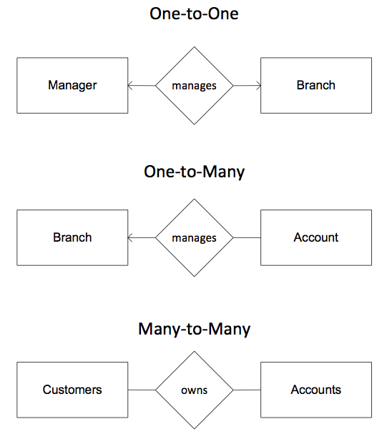
ARROW Notations

Slide 5
Weak entity and Weak Relationship
Weak Entity
Entity Set
Relationship set
Weak relationship

Slide 6

Total participation and Partial Participation
Total Participation is when each entity in the entity set occurs in at least one relationship in that relationship set.

Slide 8
Exercise (Conti) – Identify Cardinality
A company has several departments. Each department has a supervisor and at least one employee. Every supervisor has only one department under him. Employees must be assigned to at least one, but possibly more departments. At least one employee is assigned to a project. Each employee is assigned atleast one project .The important data fields are the names of the departments, projects, supervisors and employees, as well as the supervisor and employee number and a unique project number.

Slide 9
Cardinality
Supervisor –
Each department has one supervisor.
Department –
Each supervisor has one department. –
Each employee can belong to one or more departments
Employee –
Each department must have one or more employees
Each project must have one or more employees
Project
Each employee can have one or more projects.

Slide 10
Identify cardinality
S_id
S_name
P_name
P_no
project
supervisor
works
Each employee can belong to one or more departments
Each department must have one or more employees
manages
assigned
Employee
Department
E_id
E_name
D_id
D_name

Slide 11
Foreign key and Cardinality
Department( D_id , D_name)
Employee(E_id , E_name , D_id)
assigned
Employee
Department
E_id
E_name
D_id
D_name

Slide 12
Foreign key
Foreign key attributes are understood from the cardinality
Example :
Students enrolled for many courses
student
enrolls
course
reg_date
Descriptive attribute
Student (s_id , s_name )
course(cid, came)
enroll( s_id , c_id , reg_date)

Slide 13

Steps to draw ERD

Slide 14
Summary
Entity | Attributes | Cardinality | Participation
Strong Entity Weak Entity | Simple Composite Multi valued Complex Derived | One to one One to many Many to one Many to many | Total participation Partial Participation

Slide 15
EXERCISE 2
Employees work in departments;
each department is managed by an employee;
a child must be identified uniquely by name when the parent (who is an employee; assume that only one parent works for the company) is known.
We are not interested in information about a child once the parent leaves the company.
Draw an ER diagram that captures this information.

Slide 16
Exercise 2
Solution
dname
salary
skills
dno
ssn
budget
Employees
Departments
Manages
address
Door_no
Dependent
city
Works_In
Child
age
Child
name
- - - - -
name
dob

Slide 17
In a university, a Student enrolls in Courses. A student must be assigned to at least one or more Courses. Each course is taught by a single Professor. To maintain instruction quality, a Professor can deliver only one course
Nouns – Objects – Entities
Verbs – Relationship
Features – Attributes

Slide 18
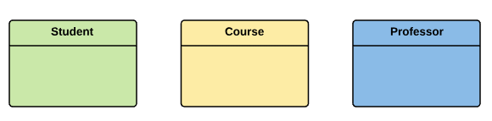
EXERCISE 3
In a university, a Student enrolls in Courses. A student must be assigned to at least one or more Courses. Each course is taught by a single Professor. To maintain instruction quality, a Professor can deliver only one course
Identify entity

Slide 19
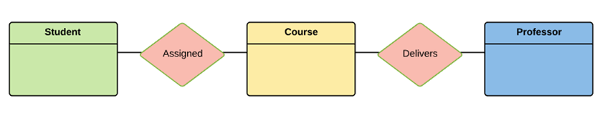
In a university, a Student enrolls in Courses. A student must be assigned to at least one or more Courses. Each course is taught by a single Professor. To maintain instruction quality, a Professor can deliver only one course
Identify relationships

Slide 20
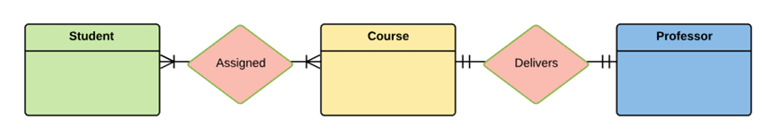
Identify cardinality
Student can take multiple course
Professor can handle only 1 course

Slide 21
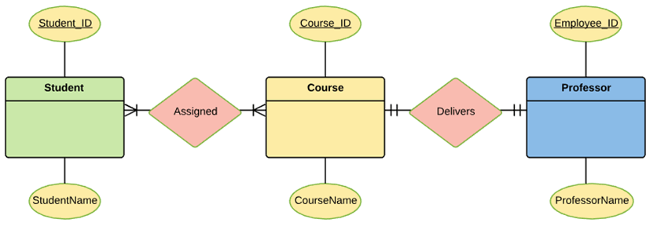
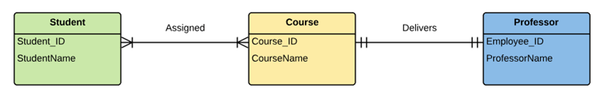
Identify Attributes
Final ERD

Slide 22
S_id
c_id
c_name
enrolls
Student
course
S_name
delivers
p_id
p_name
Professor
Ph_no

Slide 23
THANK YOU

